Slide 1
Bank Marketing Campaign

Slide 2
Introduction
A bank is trying to evaluate its marketing campaign and using the existing data to determine what makes a marketing campaign successful

Slide 3

Exploratory Data Analysis

Slide 4
Data Columns
Column Name | Description | Column Name | Description
Age | Numerical | Campaign | Numeric
Job | Numerical | Pdays | Numeric
Martial Status | Categorical | Previous | Numeric
Education | Categorical | Poutcome | Categorical
Default | Categorical | Emp.var.rate | Numeric
Housing | Categorical | Cons.price.idx | Numeric
Loan | Categorical | Cons.conf.idx | Numeric
Contact | Categorical | Euribor3m | Numeric
Month | Categorical | Nr.employed | Numeric
Day of Week | Categorical | y | Categorical
Duration | Numeric

Slide 5
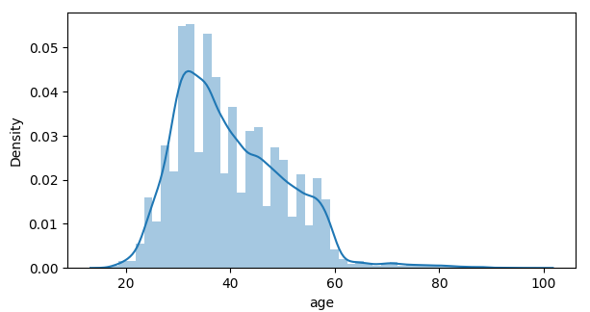
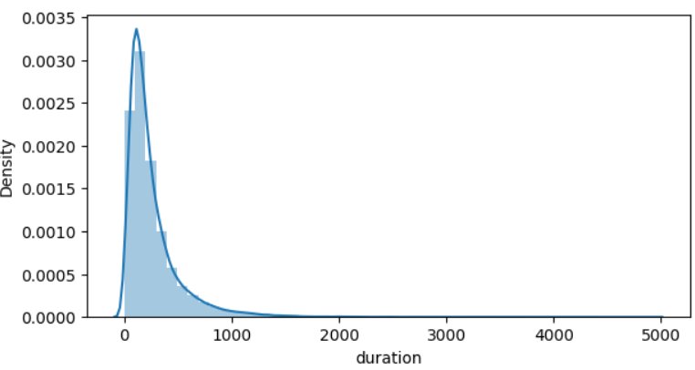
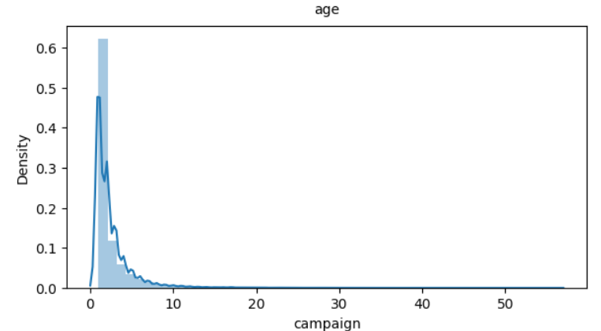
Distributions of Numerical Variables
Age
Duration
Campaign

Slide 6
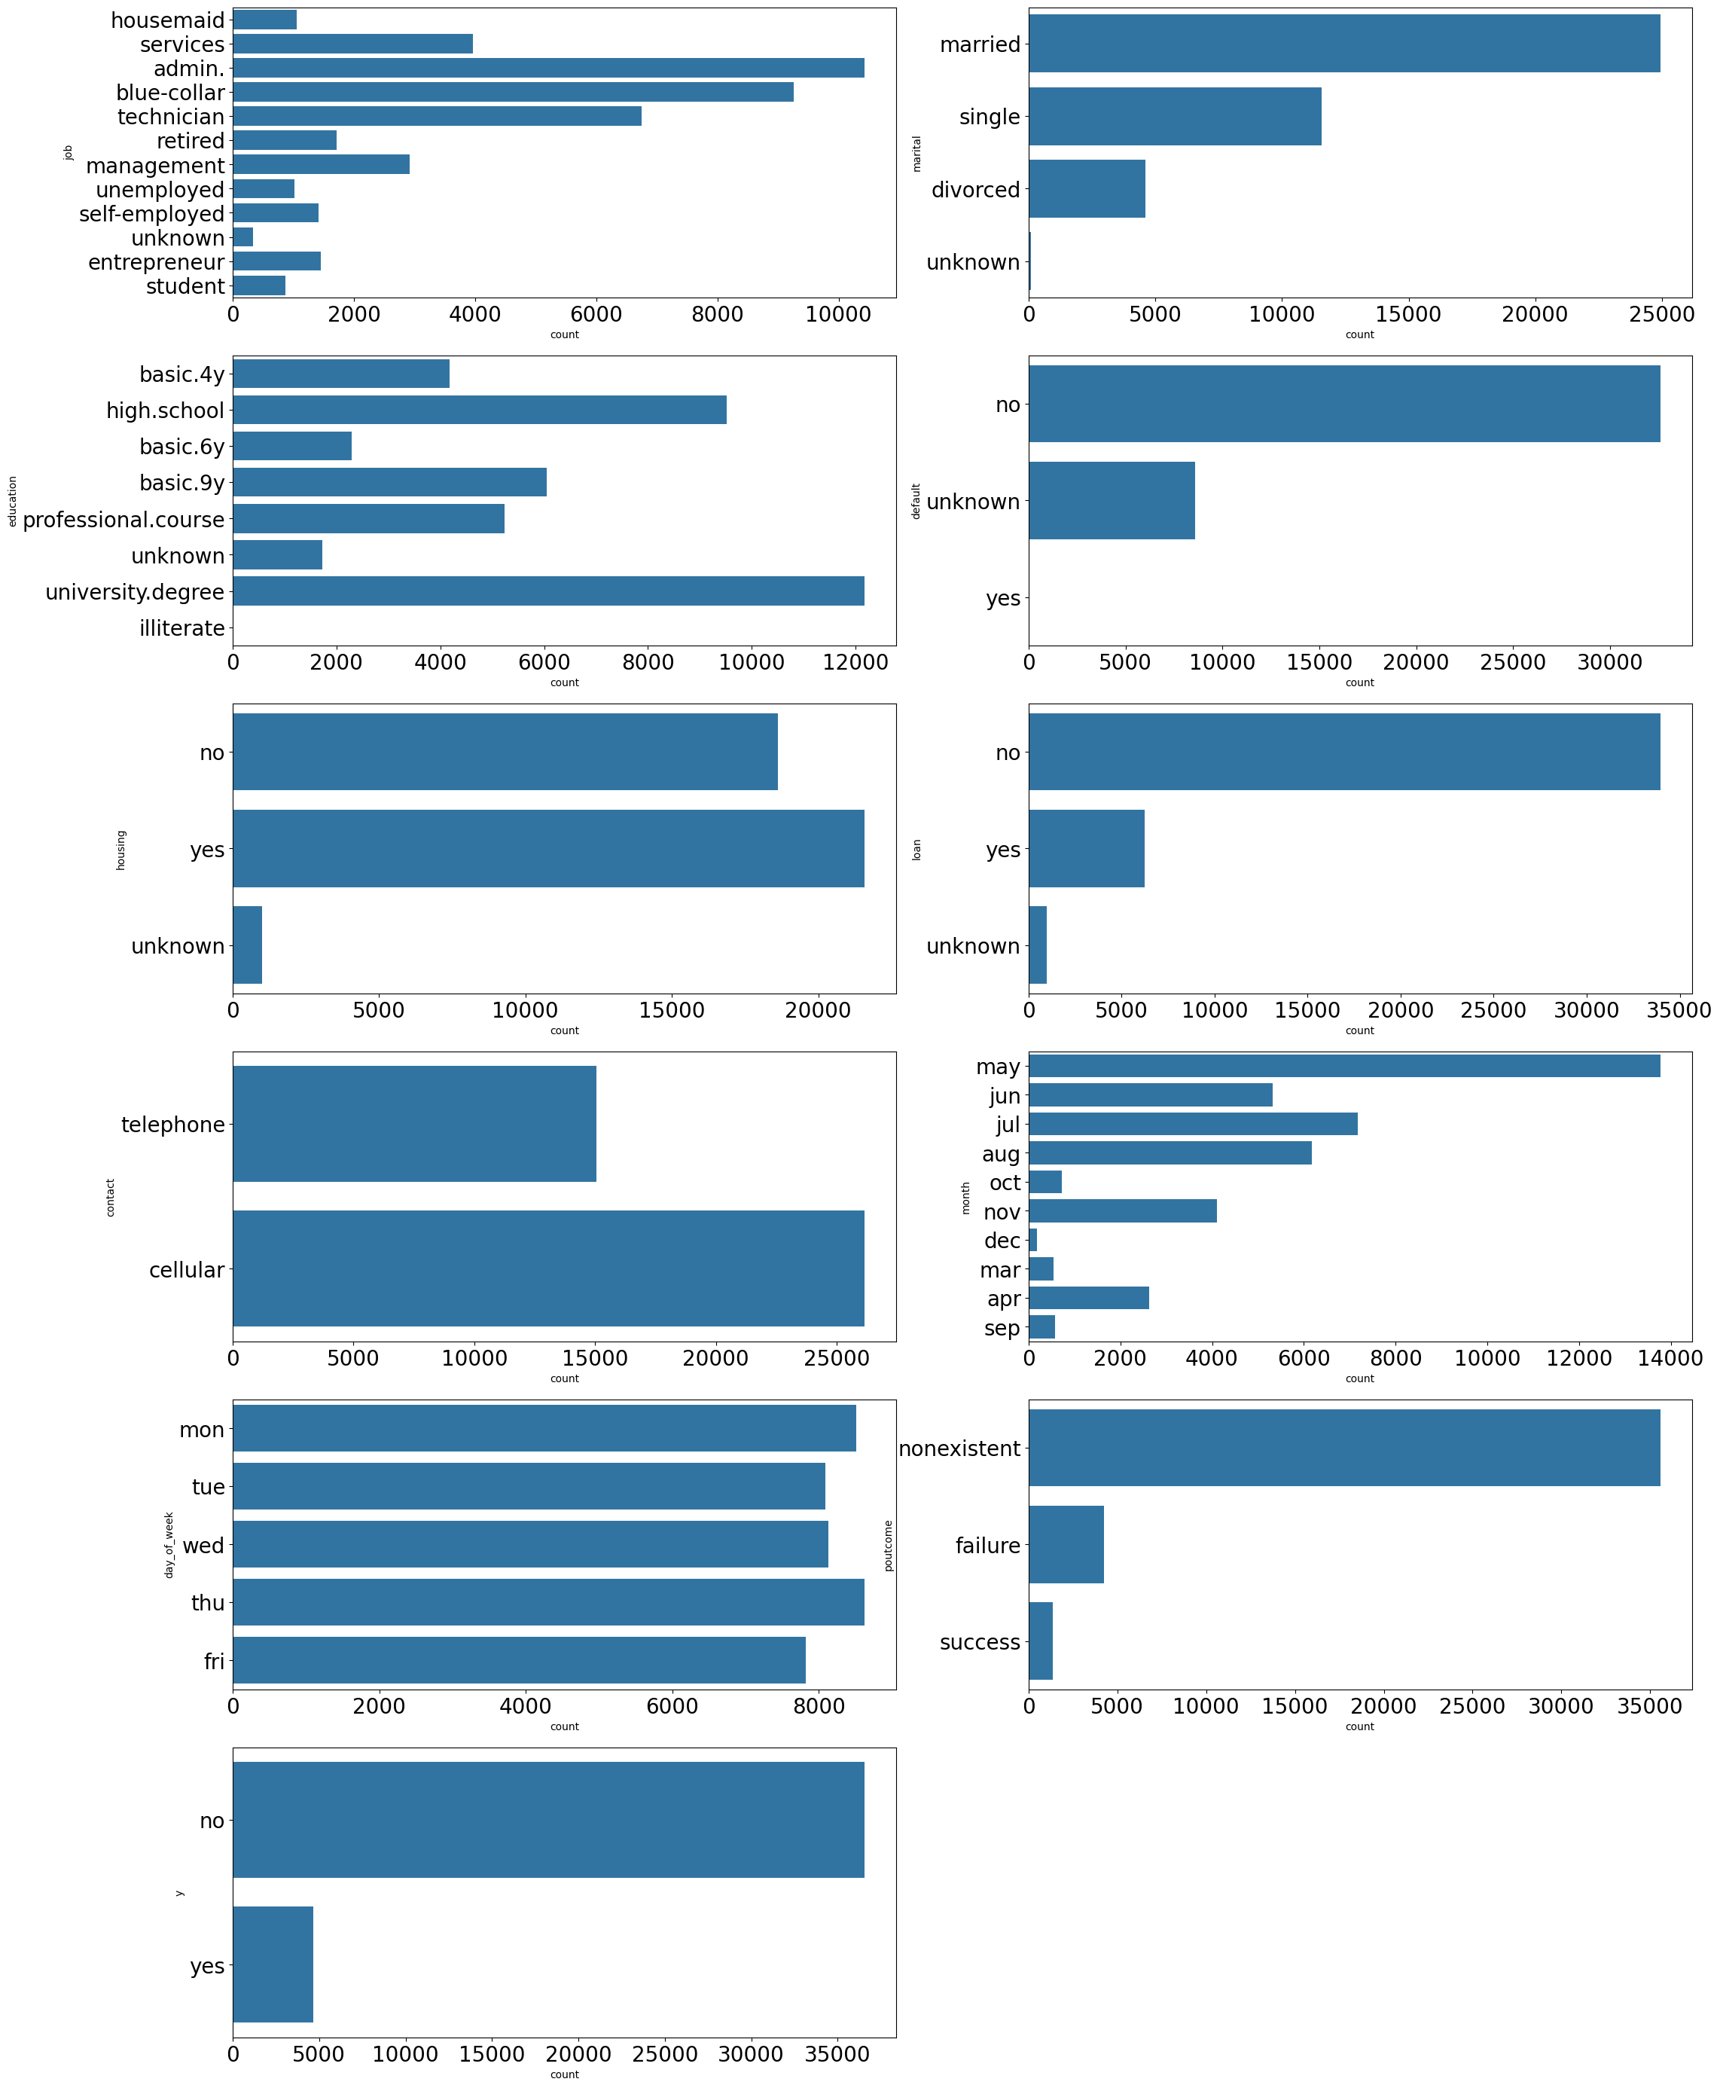
Distribution of Categorical Features

Slide 7


Outcome of Marketing Campaign
11.3% Successful
88.7% Failed

Slide 8

Constructing a Hypothesis
We will take a closer look at the data to determine what exactly we want to test for

Slide 9
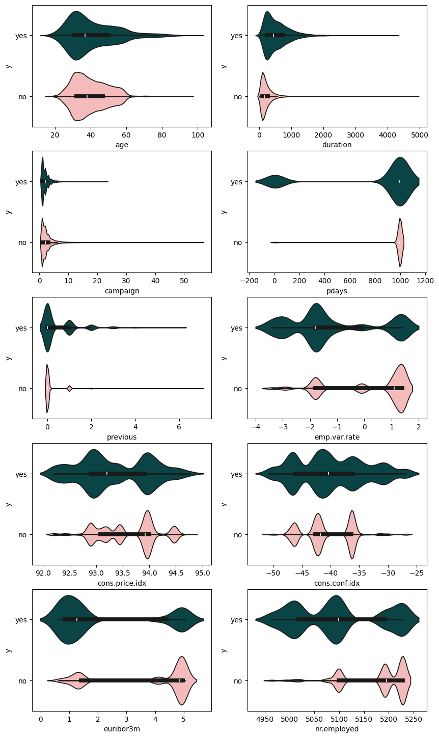
Effect of Numerical Features

Slide 10


$$x_{i}:Feature Number i \\ μ_{i}|yes=Average of x_{i} for all data entries with a successful outcome \\ μ_{i}|no=Average of x_{i} for all data entries with an unsuccessful outcome$$
$$H_{0}:μ_{i}\left|yes=μ_{i}\right|no \\ H_{a}:μ_{i}|yes≠μ_{i}|no$$

Slide 11
Hypothesis Test Result
Column | Mean_yes | Mean_no | T-statistic | Pvalue
age | 40.913147 | 39.911185 | 6.1721 | 0.0
duration | 553.191164 | 220.844807 | 89.9672 | 0.0
campaign | 2.051724 | 2.633085 | -13.4965 | 0.0
pdays | 792.035560 | 984.113878 | -69.7221 | 0.0
previous | 0.492672 | 0.132374 | 48.0027 | 0.0
emp.var.rate | -1.233448 | 0.248875 | -63.4337 | 0.0
cons.price.idx | 93.354386 | 93.603757 | -27.9032 | 0.0
cons.conf.idx | -39.789784 | -40.593097 | 11.1539 | 0.0
euribor3m | 2.123135 | 3.811491 | -65.6466 | 0.0
nr.employed | 5095.115991 | 5176.166600 | -76.9845 | 0.0

Slide 12
Kolmogorov Smirnov Test
The Kolmogorov Smirnov Tests for similarity between 2 distributions.
We will use a Kolmogorov Smirnov Test to further verify that the distributions of the successful and unsuccessful outcome aren’t equal as was made clear by the violin plots
$$H_{0}:All the values of x_{i} come from the same distribution regardless if the outcome was succesful or not \\ H_{a}:The values of x_{i} if the outcome was succesful come from a distribution than if it wasn^{′}t$$

Slide 13
Kolmogorov Smirnov Test Results
Column | KS Stat | P Value
age | 0.0861 | 0.0
duration | 0.4641 | 0.0
campaign | 0.0808 | 0.0
pdays | 0.1934 | 0.0
previous | 0.2102 | 0.0
emp.var.rate | 0.4324 | 0.0
cons.price.idx | 0.2281 | 0.0
cons.conf.idx | 0.1998 | 0.0
euribor3m | 0.4326 | 0.0
nr.employed | 0.4324 | 0.0

Slide 14

Detecting Correlation

Slide 15
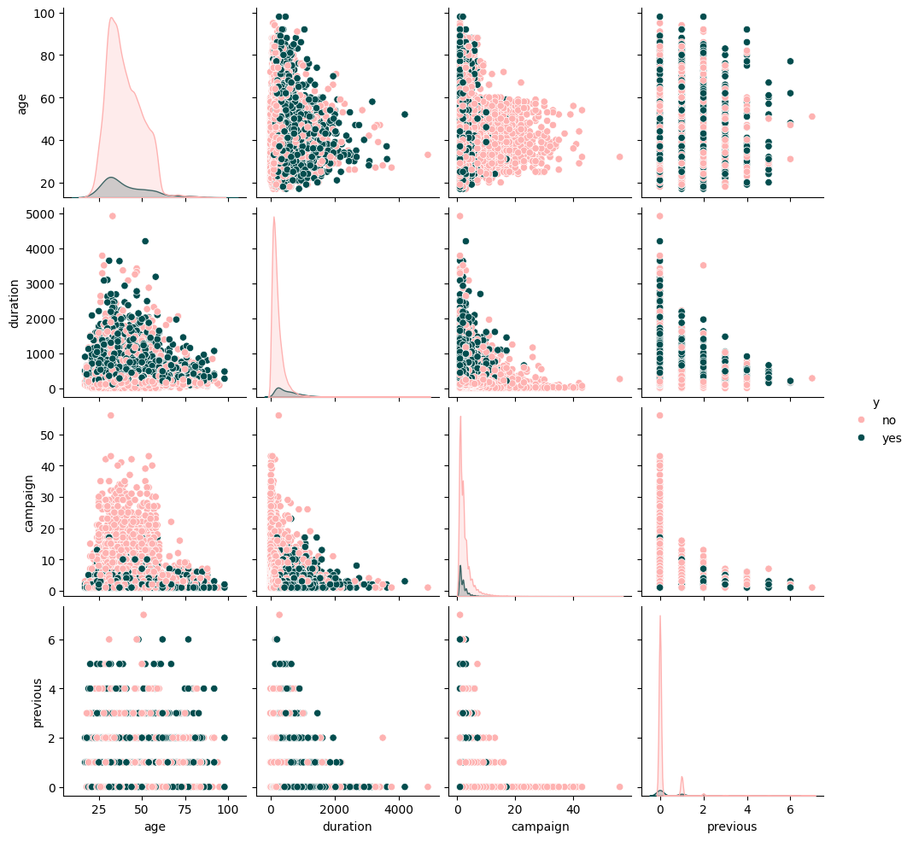
Pairwise Plots Campaign Features

Slide 16
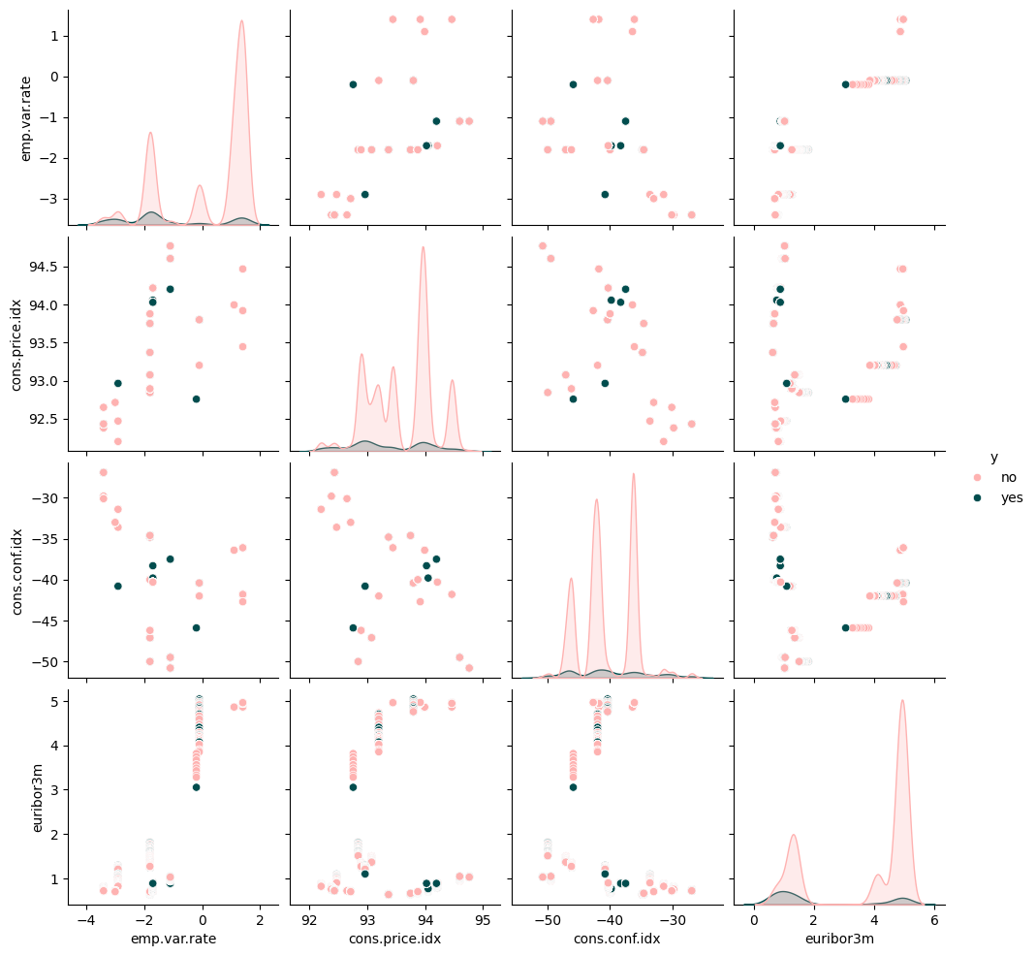
Pairwise Plots Financial Features

Slide 17
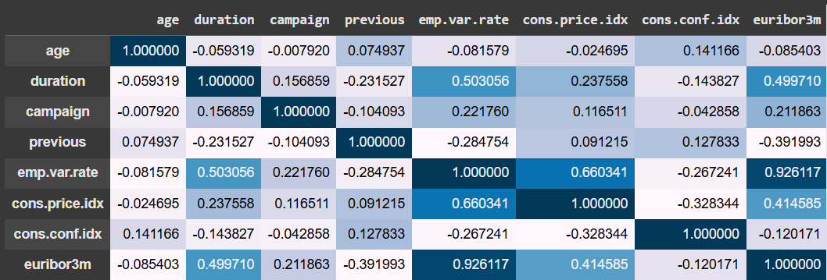
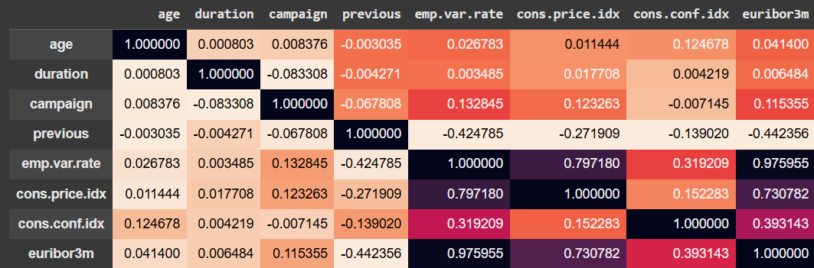
Correlation Matrix

Slide 18
Analyzing the Correlation
 | Yes | No
Cons.conf.idx vs emp.var.rate | 0.27 | 0.32
Cons.conf.idx vs cons,price.idx | 0.33 | 0.15
Cons.conf.idx vs euribor3m | 0.12 | 0.39
The consumer confidence index is negatively correlated with the other variables for successful calls but positively correlated for unsuccessful calls

Slide 19

Making Predictions

Slide 20
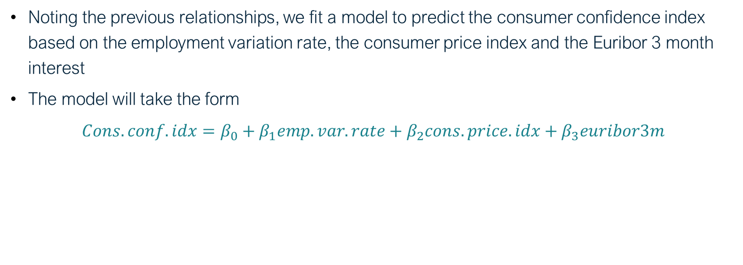
Linear Regression Model
Noting the previous relationships, we fit a model to predict the consumer confidence index based on the employment variation rate, the consumer price index and the Euribor 3 month interest
The model will take the form
$$Cons.conf.idx=β_{0}+β_{1}emp.var.rate+β_{2}cons.price.idx+β_{3}euribor3m$$

Slide 21
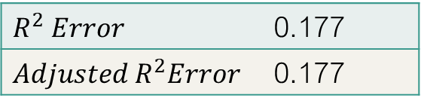
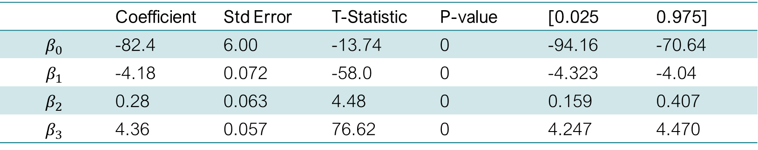
Interpretation of Linear Model
 | Coefficient | Std Error | T-Statistic | P-value | [0.025 | 0.975]
$$β_{0}$$ | -82.4 | 6.00 | -13.74 | 0 | -94.16 | -70.64
$$β_{1}$$ | -4.18 | 0.072 | -58.0 | 0 | -4.323 | -4.04
$$β_{2}$$ | 0.28 | 0.063 | 4.48 | 0 | 0.159 | 0.407
$$β_{3}$$ | 4.36 | 0.057 | 76.62 | 0 | 4.247 | 4.470
$R^{2} Error$ | 0.177
$$Adjusted R^{2}Error$$ | 0.177

Slide 22
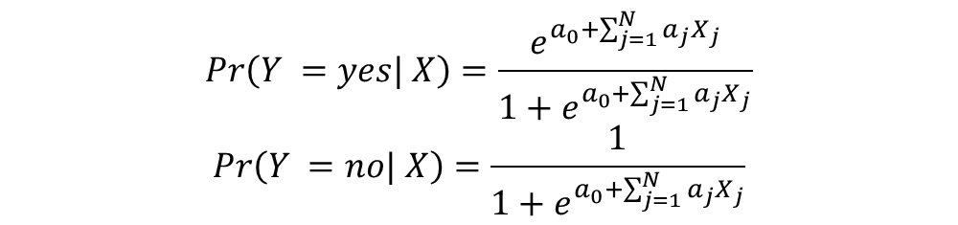
Logistic Regression Model
We next aim to create a logistic regression model to predict whether the outcome of a call will be successful or not based on the user’s data.
The logistic regression equations will be as shown below
$$Pr\left(Y =yes| X\right)=\frac{e^{a_{0}+\sum_{j=1}^{N}{a_{j}X_{j}}}}{1+e^{a_{0}+\sum_{j=1}^{N}{a_{j}X_{j}}}}$$
$$Pr\left(Y =no| X\right)=\frac{1}{1+e^{a_{0}+\sum_{j=1}^{N}{a_{j}X_{j}}}}$$

Slide 23
Deciding on Variables
We first try fitting a model that includes all variables however that yields an in significant result for most of the coefficients.
We use the result of that model and choose all features that have a coefficient p-value<0.5
The final features we include in the model are duration, campaign, pdays, cons.price.idx, cons.conf.idx, and euribor3m

Slide 24
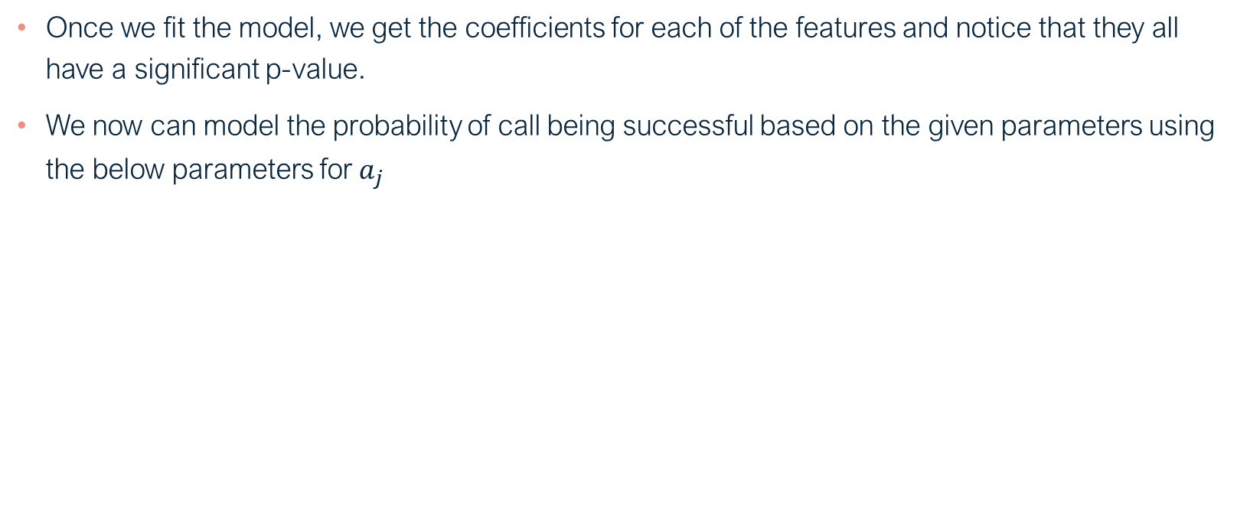
Interpretation of Logistic Model
Once we fit the model, we get the coefficients for each of the features and notice that they all have a significant p-value.
We now can model the probability of call being successful based on the given parameters using the below parameters for $a_{j}$
 | Coefficient | Std Error | T-Statistic | P-value | [0.025 | 0.975]
constant | -43.1 | 3.52 | -12.2 | 0 | -50 | -36.2
Duration | 0.0045 | ~0 | 63.5 | 0 | 0.004 | 0.005
Campaign | -0.0495 | 0.011 | -4.33 | 0 | -0.072 | -0.027
Pdays | -0.0016 | ~0 | -23 | 0 | -0.002 | -0.001
Cons.price.idx | 0.49 | 0.038 | 23.9 | 0 | 0.417 | 0.567
Cons.conf.idx | 0.07 | 0.003 | 20.1 | 0 | 0.063 | 0.077
euribor3m | 0.72 | 0.015 | -47.4 | 0 | -0.75 | -0.69

Slide 25
Thank you

